Slide 1


Introduction to UNIX command line and high-performance computing
Requires LINUX or Mac Operating Systems
Serghei Mangul, Ph.D.
Aaron Karlsberg
University of Southern California, School of Pharmacy
@serghei_mangul
@A4RONK

Slide 2
Introduction to UNIX command-line
Day 1
Unix - Learning the essentials
Unix fundamentals , syntax and usage
Day 2
Unix commands
Useful tools for processing text files
Day 3
Useful shell commands
UNIX Shell Scripting
Connect To USC’s High Performance Cluster

Slide 3
Learning Objectives
By the end of this module, students will be able to:
List the attributes of Unix that make it ideal for addressing complicated biological questions using computers
Compare and contrast the Command Line Interface (CLI) vs the Graphical User Interface (GUI)
Identify the uses of the multiple UNIX commands
pwd, mkdir, and cd and use them to navigate within the UNIX file system
Connect to and utilize high performance clusters

Slide 4
Introduction to UNIX Command Line: Learning Objectives
By the end of this module, students will be able to:
Perform the following tasks within the UNIX environment:
Create a text file
List and reorder files
Display, copy, move, and delete directories and files
Use grep command to search text in the txt files
Use awk to process tab delimited files
Use sed to edit text in the txt files
Connect to high performance cluster

Slide 5
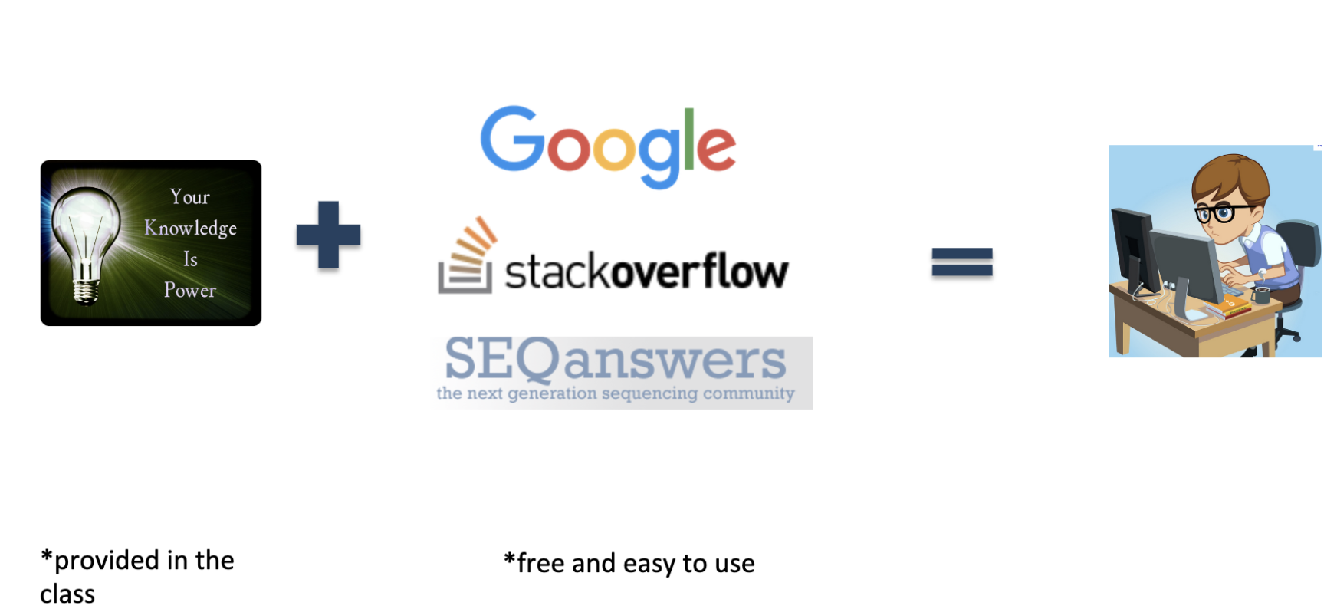
Do biomedical researchers have to become programmers?

Slide 6
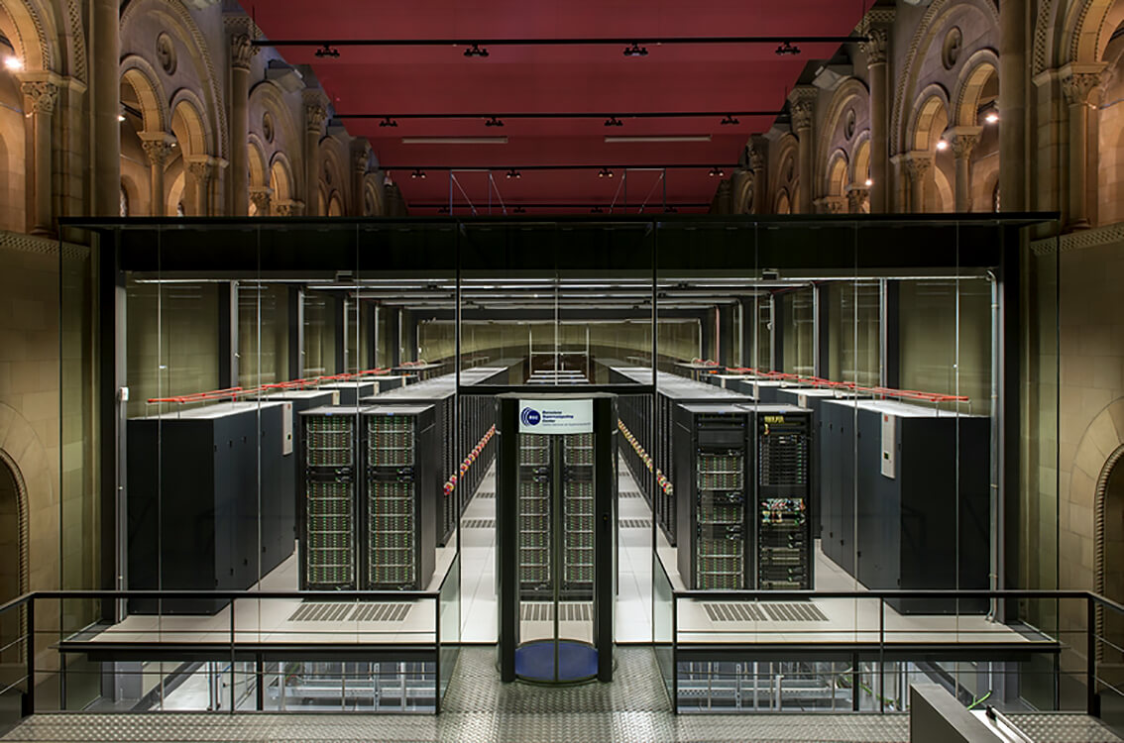
Why Learn Unix?
As biological data sets have grown larger and biological problems have become more complex, the requirements for computing power have also grown.
Computers that can provide this power generally use the Unix operating system
BSC-CNS | Barcelona Supercomputing Center

Slide 7
Why Learn Unix?
Most new bioinformatics software is created for Unix
Unix is very efficient
manage extremely huge amounts of data
It is very popular, so it is easy to find information and get help
Unix is very stable - computers running Unix almost never crash
Notes:
Unix is used by most large, powerful computers
Graphical User Interface at Mac and Windows
Unix – command line interface, called shell

Slide 8



Why not MS Excel?
Excel is good for simple tasks and small datasets
Excel is not eble to handle large datasets above 1,048,576 rows and 16,384 columns
Excel is not suitable for large number of datasets.

Slide 9
What is Unix?
UNIX-like system (e.g Linux, Ubuntu) is a type of operating system that lack a graphical interface and require inputting code.
UNIX environment is often is referred as command line interface opposed to graphical interface, which is common for Windows and MacOS.

Slide 10

The Unix Shell
A shell is a program that waits for you to type a command and then executes it.
type the command, then “return”
Notes:
Try to type anything

Slide 11
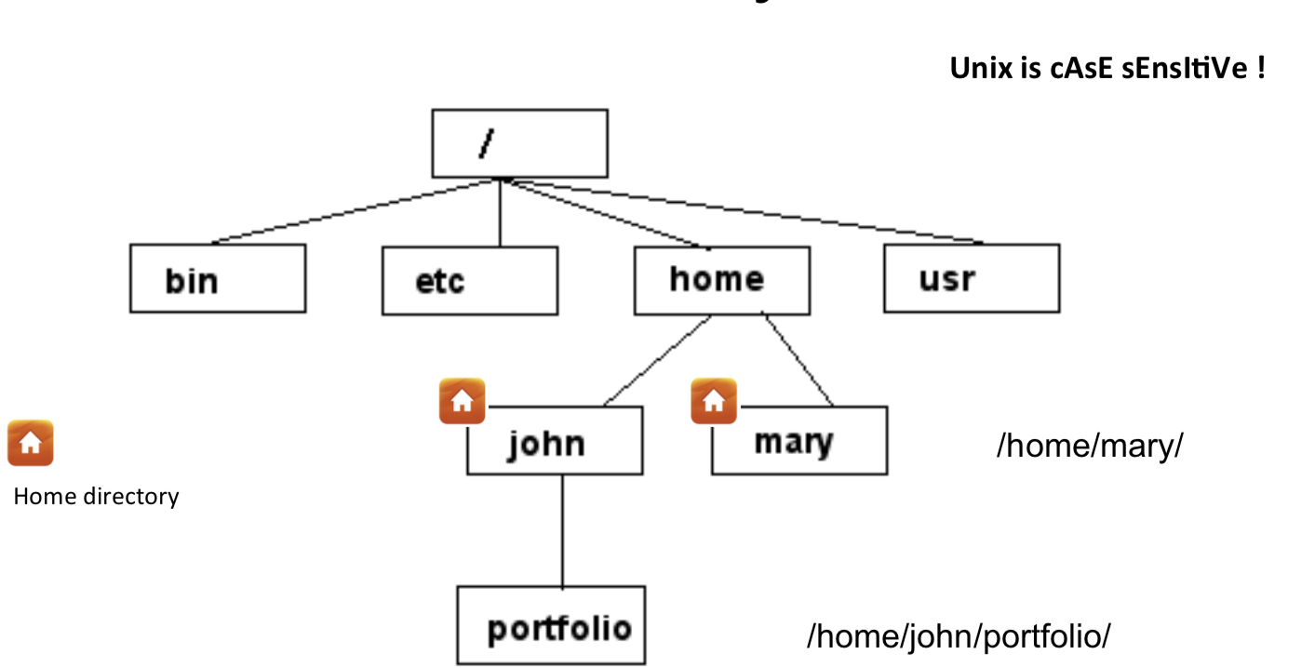
Unix File System
my home directory
path
My laptop : /Users/serghei
Notes:
Folders - >dir
Type pwd

Slide 12

Home directory
When you open terminal, you always start in your Home directory.
Create sub-directories in your home or other directory to store specific projects or groups of information
Do not accumulate thousands of files with cryptic names in your Home directory

Slide 13
Command: pwd
To display current directory
[serghei@login3 ~]$ pwd
/u/home/s/serghei
Notes:
Since it is command line interface let’s learn few commands

Slide 14

Command: mkdir
To create a new directory use “mkdir”
[serghei@login3 ~]$ mkdir test
If no error message is displayed means the command was run successfully

Slide 15
Command: cd
cd changes your current working directory
cd test
pwd
/u/home/s/serghei/test
Notes:
cd t “tab”, to auto-complete file names, use the tab key

Slide 16
Command: cd
“~” is the location of your home directory
“..” is the location of the directory above the current one
/Users/serghei
my home directory
/Users/serghei/test
/Users/serghei/test

Slide 17

Let’s practice
[serghei@login3 test]$ cd ~
[serghei@login3 ~]$ pwd
/u/home/s/serghei
[serghei@login3 ~]$ cd ..
[serghei@login3 s]$ pwd
/u/home/s
[serghei@login3 s]$ cd
/u/home/s/serghei

Slide 18


to go back to previously entered commands, use the up and down arrows
to auto-complete file names, use the tab key
if you are stuck within a command/process/program, try ctrl-z to terminate it

Slide 19
Let’s practice
mkdir jdkhfkjdsfhkjsdhfkjsdhfkjhs
cd jdkhfkjdsfhkjsdhfkjsdhfkjhs

Slide 20
Create a text file
[serghei@login3 ~]$ vi test.txt
On-screen, you will see blank lines, each with a tilde (~) at the left, and a line at the bottom giving the name and status of the new file:
Press “i” to edit the file
Press
“ESC” (insert mode is gone)
“SHIFT” + ”;” (you should see on the screen :wq)
“wq” (w – save file, q- quit) OR “q!” (discard changes and quit file)
“ENTER”
~
"test.txt" [New File]
~
-- INSERT --
~
:wq
~
:q!

Slide 21
Command : ls
to list the files in the current directory
ls has many options
-l long list (displays lots of info)
-t sort by modification time
-S sort by size
-h list file sizes in human readable format
-r reverse the order
Options can be combined: “ls -lh”
Notes:
Whenever you need help with a command type “man” and the command name

Slide 22
Let’s practice!
[serghei@login3 test]$ ls
jdkhfkjdsfhkjsdhfkjsdhfkjhsdjfk test.txt
[serghei@login3 test]$ ls -l
total 8
drwxr-xr-x 2 serghei eeskin 4096 Sep 8 09:35 jdkhfkjdsfhkjsdhfkjsdhfkjhsdjfk
-rw-r--r-- 1 serghei eeskin 80 Sep 8 09:50 test.txt
[serghei@login3 test]$ ls -lh
total 8.0K
drwxr-xr-x 2 serghei eeskin 4.0K Sep 8 09:35 jdkhfkjdsfhkjsdhfkjsdhfkjhsdjfk
-rw-r--r-- 1 serghei eeskin 80 Sep 8 09:50 test.txt
Notes:
Many option might be confusing, how to get help!

Slide 23


How to know more?
MANUAL
GOOGLE

Slide 24

Command : man
displays manual pages
[serghei@login3 test]$ man ls
LS(1) BSD General Commands Manual LS(1)
NAME
ls -- list directory contents
press q to

Slide 25


Slide 26
General Syntax: *
“*” can be used as a wildcard in Unix
[serghei@login3 test]$ ls *txt
test.txt
[serghei@login3 test]$ ls t*g
test.log
[serghei@login3 test]$ ls t*
test.log
test.txt

Slide 27
Displaying a file
Various ways to display a file in Unix
cat
less
head
tail

Slide 28
Command: cat
dumps an entire file to standard output
good for displaying short, simple files
[serghei@login3 test]$ cat test.txt
My first txt file!

Slide 29
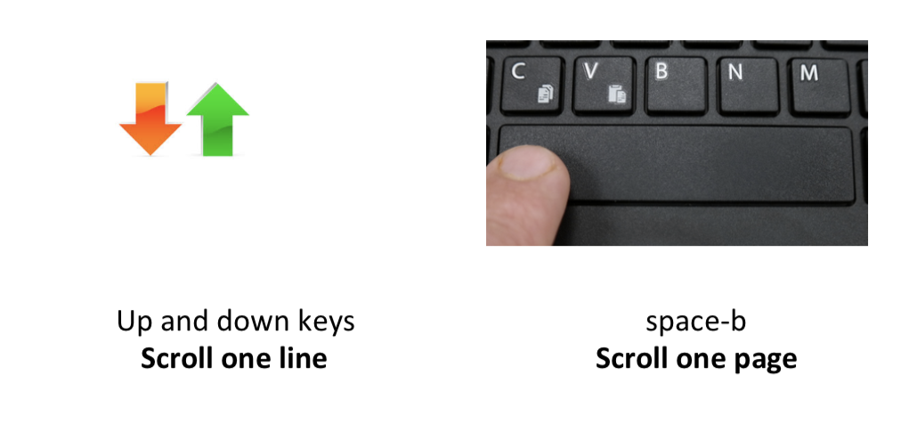
Command: less
Scrolling through a file without a mouse
press q to

Slide 30


Let’s practice!
[serghei@login3 test]$ less large.txt
1
2
3
4
5
6
7
…
30
Try to scroll forward/back one line/page!

Slide 31
Command: head
displays the top part of a file
by default it shows the first 10 lines
-n option allows you to change that

Slide 32
Command: tail
Same as head, but shows the last lines

Slide 33
Let’s practice!
head large.txt
1
2
…
9
10
tail large.txt
21
22
…
30
tail -n 3 large.txt
28
29
30

Slide 34



File Commands
Copying a file: cp
Move or rename a file: mv
Remove a file: rm
Notes:
Like so many Linux features, you have a variety of options from which to choose when you want to manipulate files and directories. You can also use wildcards when you're copying, moving, or deleting files and directories.

Slide 35
Copy
cp <source> <destination>
to copy a file use cp
to copy a directory use cp -r

Slide 36
Let’s practice
[serghei@login3 test]$ cp test.txt test1.txt
[serghei@login3 test]$ ls
large.txt test1.txt test.log test.txt
[serghei@login3 test]$ mkdir new
[serghei@login3 test]$ cp -r new new2
[serghei@login3 test]$ ls
large.txt new new2 test1.txt test.log test.txt
[serghei@login3 test]$ cp test.txt new/
[serghei@login3 test]$ cp test.txt new/test_new.txt
[serghei@login3 test]$ cd new
[serghei@login3 new]$ ls
test_new.txt test.txt
Notes:
Creating a copy of a file in the current directory

Slide 37

Command: mv
mv <source> <destination>
moves a file/directory to a different location
renames a file/directory
[serghei@login3 new]$ cd ..
[serghei@login3 test]$ pwd
/u/home/s/serghei/test
[serghei@login3 test]$ mv test1.txt new/
[serghei@login3 test]$ mv test.txt test_rename.txt
[serghei@login3 test]$ ls
large.txt new new2 test.log test_rename.txt
[serghei@login3 test]$ mv test.txt new/test2.txt

Slide 38
Symbolic Links
is a special kind of file that points to another file
existing file for which you want to create the symbolic link
name of the symbolic link
ln -s <ORIGINAL_FILE> <LINK_NAME>
Original file
Link
Data on the hard disc

Slide 39


Good to know
You can perform an operation on LINK_NAME, just as you could with the ORIGINAL_FILE
You can use normal file management commands (e.g., cp, rm) on the symbolic link.
Don’t modify the original file through the link

Slide 40


Command: rm
to remove a file use rm
to remove a directory use rm -r
[serghei@login3 test]$ rm test.log
[serghei@login3 test]$ rm -r new2
[serghei@login3 test]$ ls
large.txt new test_rename.txt
Files and directories deleted with rm are gone forever and cannot be recovered!!!

Slide 41
Good to know
cp/mv/rm can work on many files at once:
cp file1 file2 new/
rm file1 file2 file27
cp/mv/rm can work with *:
mv f* new/
rm f*
rm l*s
rm *txt

Slide 42

USC HPC Cluster
What is HPC?
HPC is USC’s Center for High-Performance Computing.
Provides the infrastructure and support necessary for research computing.
Supports USC’s research mission to advance scientific discovery.
HPC resources are available at no charge to USC faculty, staff, graduate students, and iVIP collaborators.
Why do we sometimes call an HPC platform a cluster?
Because it is basically a giant building on campus that houses thousands of CPUs, GPUs, and various kinds of memory units for short and long term data storage. This building is connected to the internet and made available exclusively to the USC research community for running computationally heavy tasks that are beyond the capabilities of standard computers. We think of this platform as a cluster of compute nodes where each node consists of several cpus or gpus.
What makes it so great?
Through HPC you can request compute resources according to the needs of your application.
You can access HPC from anywhere in the world.
HPC has support for storing protected health data.
Easily shareable to anyone on the USC HPC network which is great for collaboration between labs on campus.
Notes:
Try to type anything

Slide 43
HPC Accounts
Accounts are project-based
Project “PI”s “own” accounts
A PI can add members or be the sole member
Members can belong to multiple projects
Project members share quotas
PI can request increases on project website - https://hpc-web.usc.edu/project
* If you do not yet have an account, please consult with your PI. The rest of this presentation assumes you have been registered for an HPC account with USC.

Slide 44
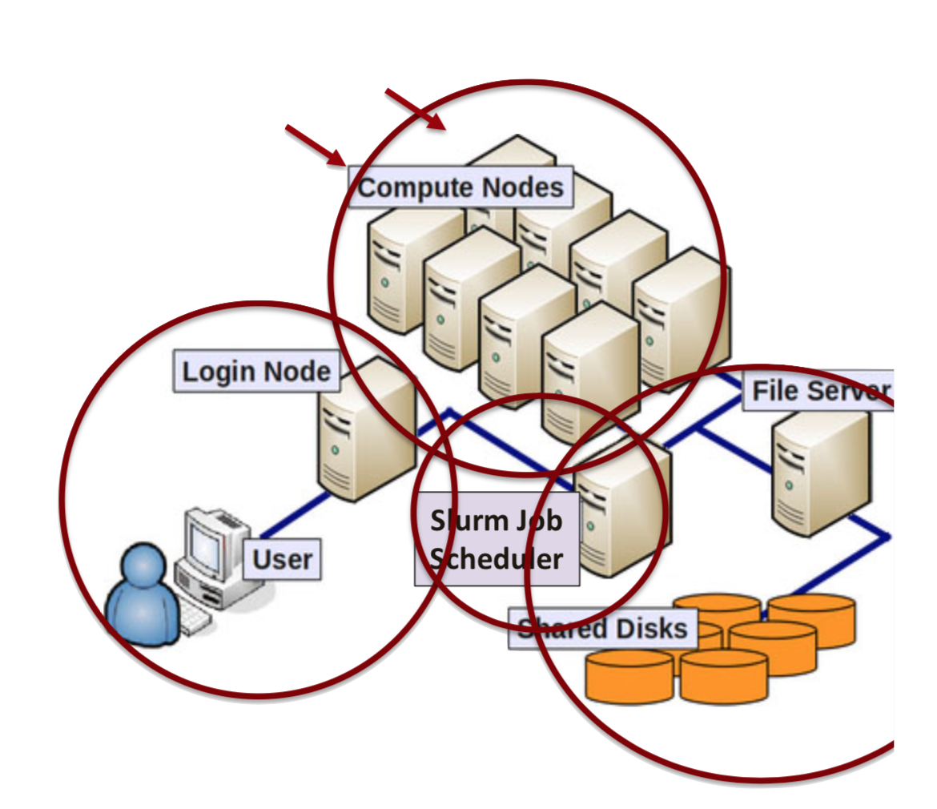
HPC Architecture
Login Node
1gb storage
Shared for all users
Minimal compute resources
Do not compute or submit jobs here. Slows down login node for everyone!
Compute Nodes
Standard 5 Terabytes of Data per shared project
Dedicated CPUs
Compute here
Submit Jobs here
Long term/permanent storage
For storing code and software packages.
Staging
10 Terabytes per user
Temporary storage lasts 6 weeks.
For storing large datasets and results.
Submit jobs here.
All nodes run a linux based operating system

Slide 45
Connecting to the Cluster
~ :> ssh username@hpc-login3.usc.edu
username@hpc-login3.usc.edu's password: your_password
Duo two-factor login for username
Enter a passcode or select one of the following options:
1. Duo Push to XXX-XXX-1232
2. Phone call to XXX-XXX-1232
3. SMS passcodes to XXX-XXX-1232
Passcode or option (1-3): 1
Success. Logging you in…
-bash-4.2$
* If you are not in range/on campus to connect to the USC secure wireless network, you must use a Virtual Private Network (VPN) client to connect to USC’s wifi network before you can access the cluster.
* Duo authentication is required so please install the app and connect your account to it.

Slide 46
Navigating Your Account
Login node: (This is only a login node. Switch to staging or project directories for storage or computation)
-bash-4.2$ pwd
/home/rcf-15/username
-bash-4.2$ ls
Compute/Project node: (software packages here)
-bash-4.2$ cd /home/rcf-proj/sm3/username
-bash-4.2$ ls
anaconda2 genomics.USC.HPC R_packages
Staging node: ( Temporary 6 week storage: 10TB per person)
-bash-4.2$ cd /staging/sm3/username
-bash-4.2$ ls
STAGING_README RNA_seq_data

Slide 47
Transfer Files To/From The Cluster
Use the transfer node for transferring large files to or from the cluster: hpc-transfer.usc.edu
scp [from] [to]
Local to cluster:
~:> scp filename username@hpc-transfer.usc.edu:/home/rcf-15/username/path
Cluster to local:
~:> scp username@hpc-transfer.usc.edu:/home/rcf-15/username/filename .
Note:
. represents the current working directory on your local machine
To move a folder, first compress into a zip-file. Then unzip once transferred.
zip -r foldername.zip foldername

Slide 48
Available Software Packages
The USC HPC comes preinstalled with many commonly used software packages.
Navigate to available packages directory and list them.
~:> cd /usr/usc
~:> ls
Identify the package and version you wish to use. Source the setup.sh file. We will use python version 3.7.4.
~:> cd python
~:> cd 3.7.4
~:> source setup.sh
Python 3.7.4 is now the current active version of python on your hpc account. When you logout, the default will return to hpc’s default version.

Slide 49
Custom software packages
Any changes you make to the libraries available within these packages will be erased when you logout and will not persist in new sessions you access.
If you spend a lot of time fine tuning the packages in your environment, then it is better to download the software from the internet and store it in your project directory. This way you can fine tune your own packages and their state will persist each time you log in.
To ensure that you use the version of software that you downloaded and not the default version available on hpc, make sure to specify the full path to your software package when using it. In the example below, you installed your own version of anaconda3 in your project directory. Specify the full path to run the python version that came with your anaconda3 installation on your unique python script called my_code.py
~:> /home/rcf-proj/sm3/username/anaconda3/bin/conda my_code.py

Slide 50
Batch Jobs (1)
Make a .sh file that invokes the scripts you wish to execute. At the top of your .sh file, insert the line: #!/bin/bash
1)
~:> vi my_job.sh
2)
Type: i
3)
~:> #!/bin/bash
4)
Type: echo “This echo command will run after I submit this my_job.sh
file to the cluster and sufficient compute resources are available”
5)
Type: esc :wq

Slide 51
Batch Jobs (2)
Run the following command in the cluster to submit your job.
~:> sbatch --job-name=A --ntasks=B --mem-per-cpu=C --time=D my_job.sh
A = name of your choosing for the job Ie. Big_Data
B = number of cpus required for job. Ie. 1
C = memory per cpu required for job. Ie. 2G
D = computation time required for your job to complete. Ie. 1:00:00
Note that the more resources you request, the longer it will take for your job to begin as there are limited resources available at any given time.

Slide 52
Monitor/Cancel Job
Show my jobs on cluster:
~:> myqueue /my jobs
JOBID PARTITION NAME USER ST TIME NODES NODELIST(REASON)
3176 quick Big_Data username PD 0:00 1 (Resources)
Cancel job
~:> scancel job_id

Slide 53
Batch Jobs (3)
Try it out
Submit the job using the script we created earlier.
~:> sbatch --job-name=BigData --ntasks=1 --mem-per-cpu=1 --time=1:00:00 my_job.sh
When the job completes, look at the slurm-7332691.out file to see the expected console text output and job stats.
~:> vi slurm-7332691.out
To exit, the text file, type: esc :q!

Slide 54
Interactive Session
To request an interactive session, use the command salloc. In the example below, four processors with two gigabytes per processor are requested for one hour.
~:> salloc --ntasks=4 --time=1:00:00 --mem-per-cpu=2GB
Test out your .sh file before submitting job to catch syntax errors early on.
~:> ./my_job.sh

Slide 55
Useful Cluster Commands
Show disk usage of account:
~:> myquota
Percent of CPU that is being used compared to what was requested:
~:> htop
Check how busy cluster is:
~:> sinfo --partition main

Slide 56
Cluster Resources
Unless your PI has purchased dedicated nodes, your jobs will be submitted to the nodes made available to the general usc hpc community. Thus your wait times for job execution will depend on the community’s usage of the cluster at any given time.
For community nodes, the max number of jobs that can run simultaneously per user is 10 with up to 99 compute nodes.
For more information on limits and more complex usage of the cluster please visit, https://hpcc.usc.edu/gettingstarted/

Slide 57
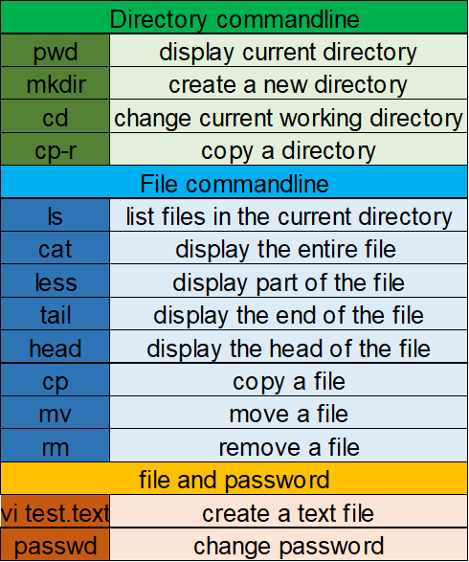
Summary
Commands
UNIX

Slide 58
Summary
Commands
Cluster
HPC Cluster
ssh
Connect to cluster
scp
Move files to and from cluster
source
Activate package in working env
sbatch
Submit Jobs to cluster
myqueue
Job monitoring
scancel
Cancel a job
salloc
Interactive Node
myquota
Cluster resources (memory)
htop
Percent of CPU usage
sinfo
Community usage of cluster

